Slide 1
Weekly meeting
7 25 2024
Ty Bottorff

Slide 2
Outline
P576 and P452 MT variant analyses faceted by responder status, timepoint (respectively)
P576 PCAs/heatmaps
New experiment ideas
Debrief of Josh’s presentation

Slide 3
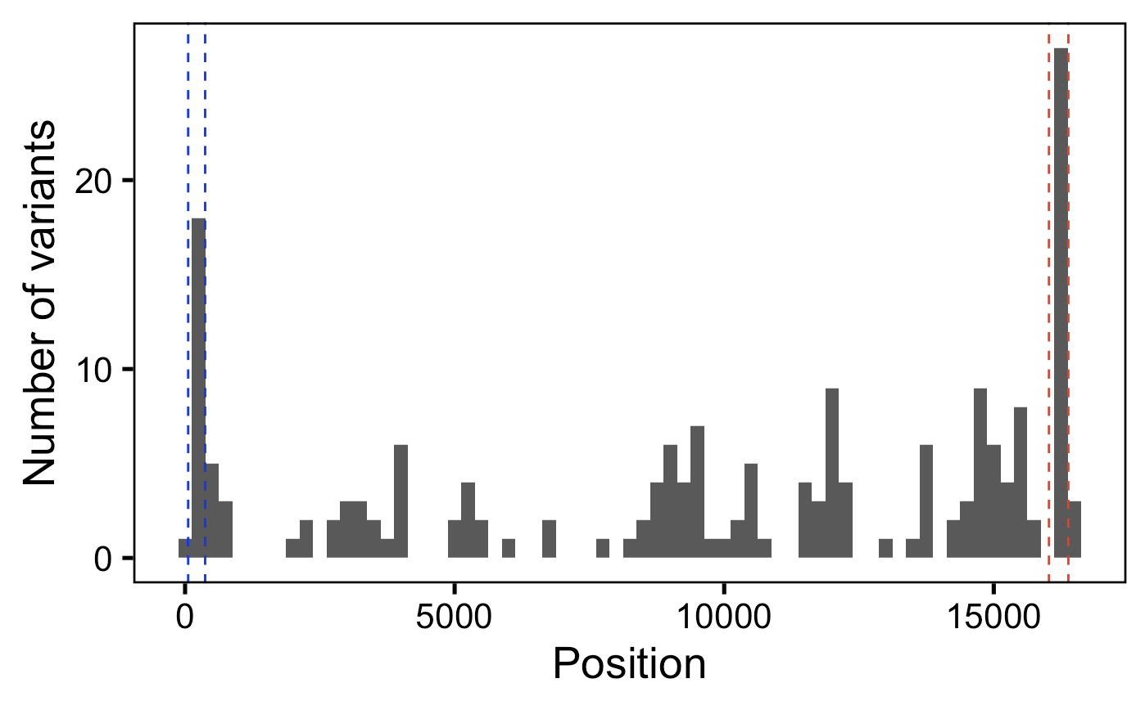
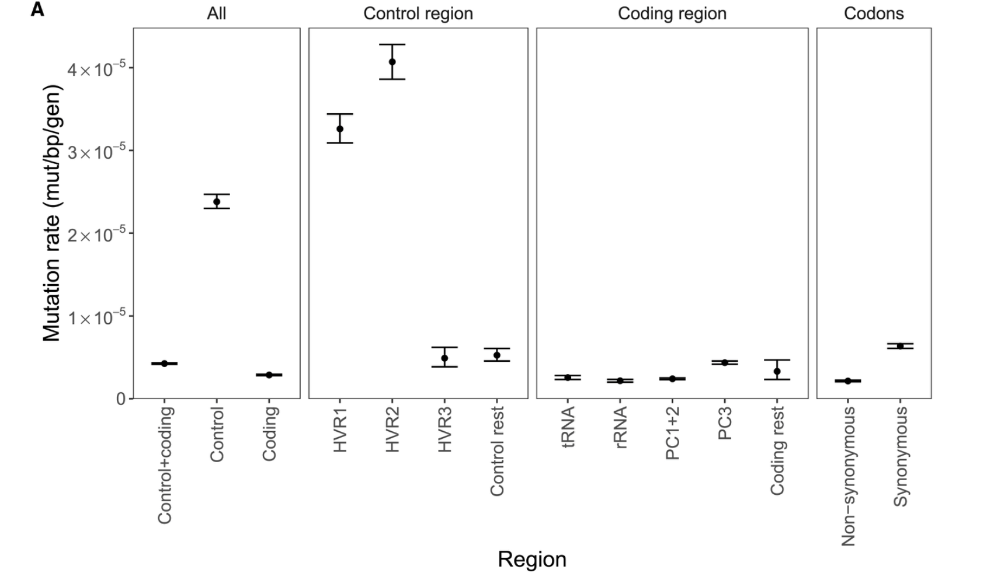
P576: SNV counts in HV1/2 vs. other regions seem to be within order of magnitude of estimated mutation rate fold differences
HV2
HV1
Árnadóttir et al. (2024) Cell

Slide 4
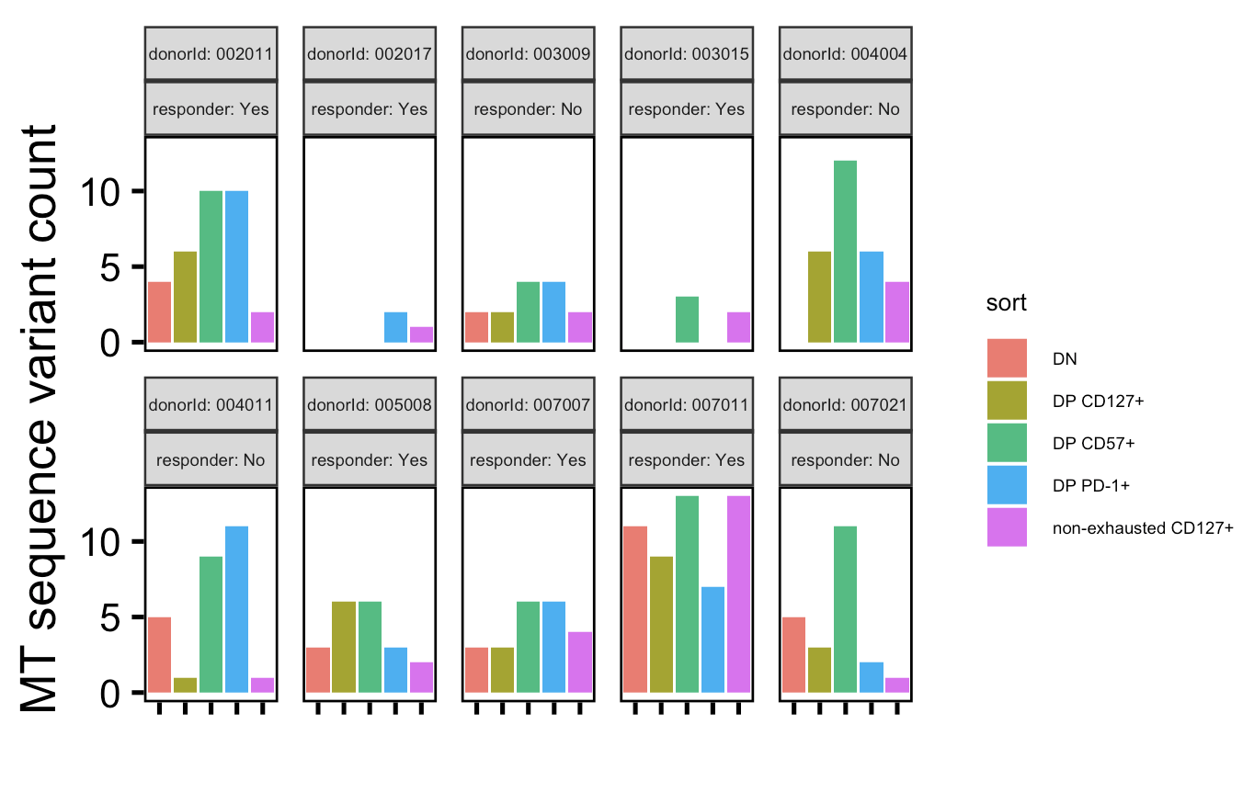
P576: MT variant ordering by cell sort is rather consistent across donors (DP CD57⁺ usually top, non-exhausted CD127⁺ usually bottom)
2 responders have low var counts, including 0 counts for multiple sorts…

Slide 5
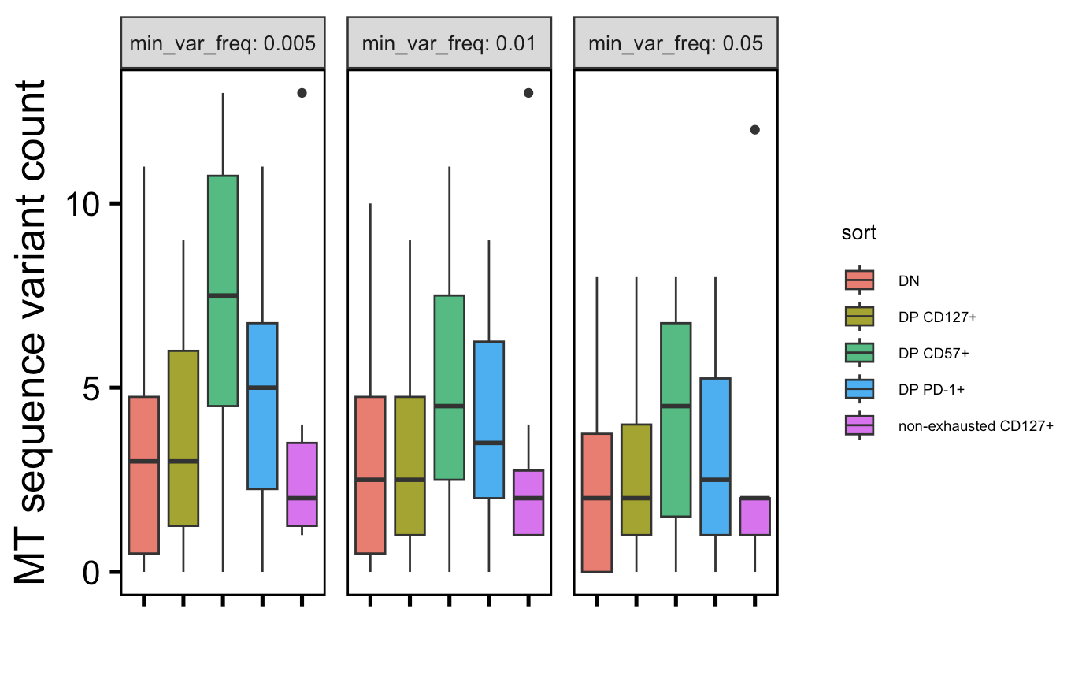
P576: still see DP CD57⁺ having more vars with inclusion of 0s, still more-so at low min_var_freq (trend dulled a bit)
*
*
*
Wilcoxon rank sum test. *; p < 0.05

Slide 6
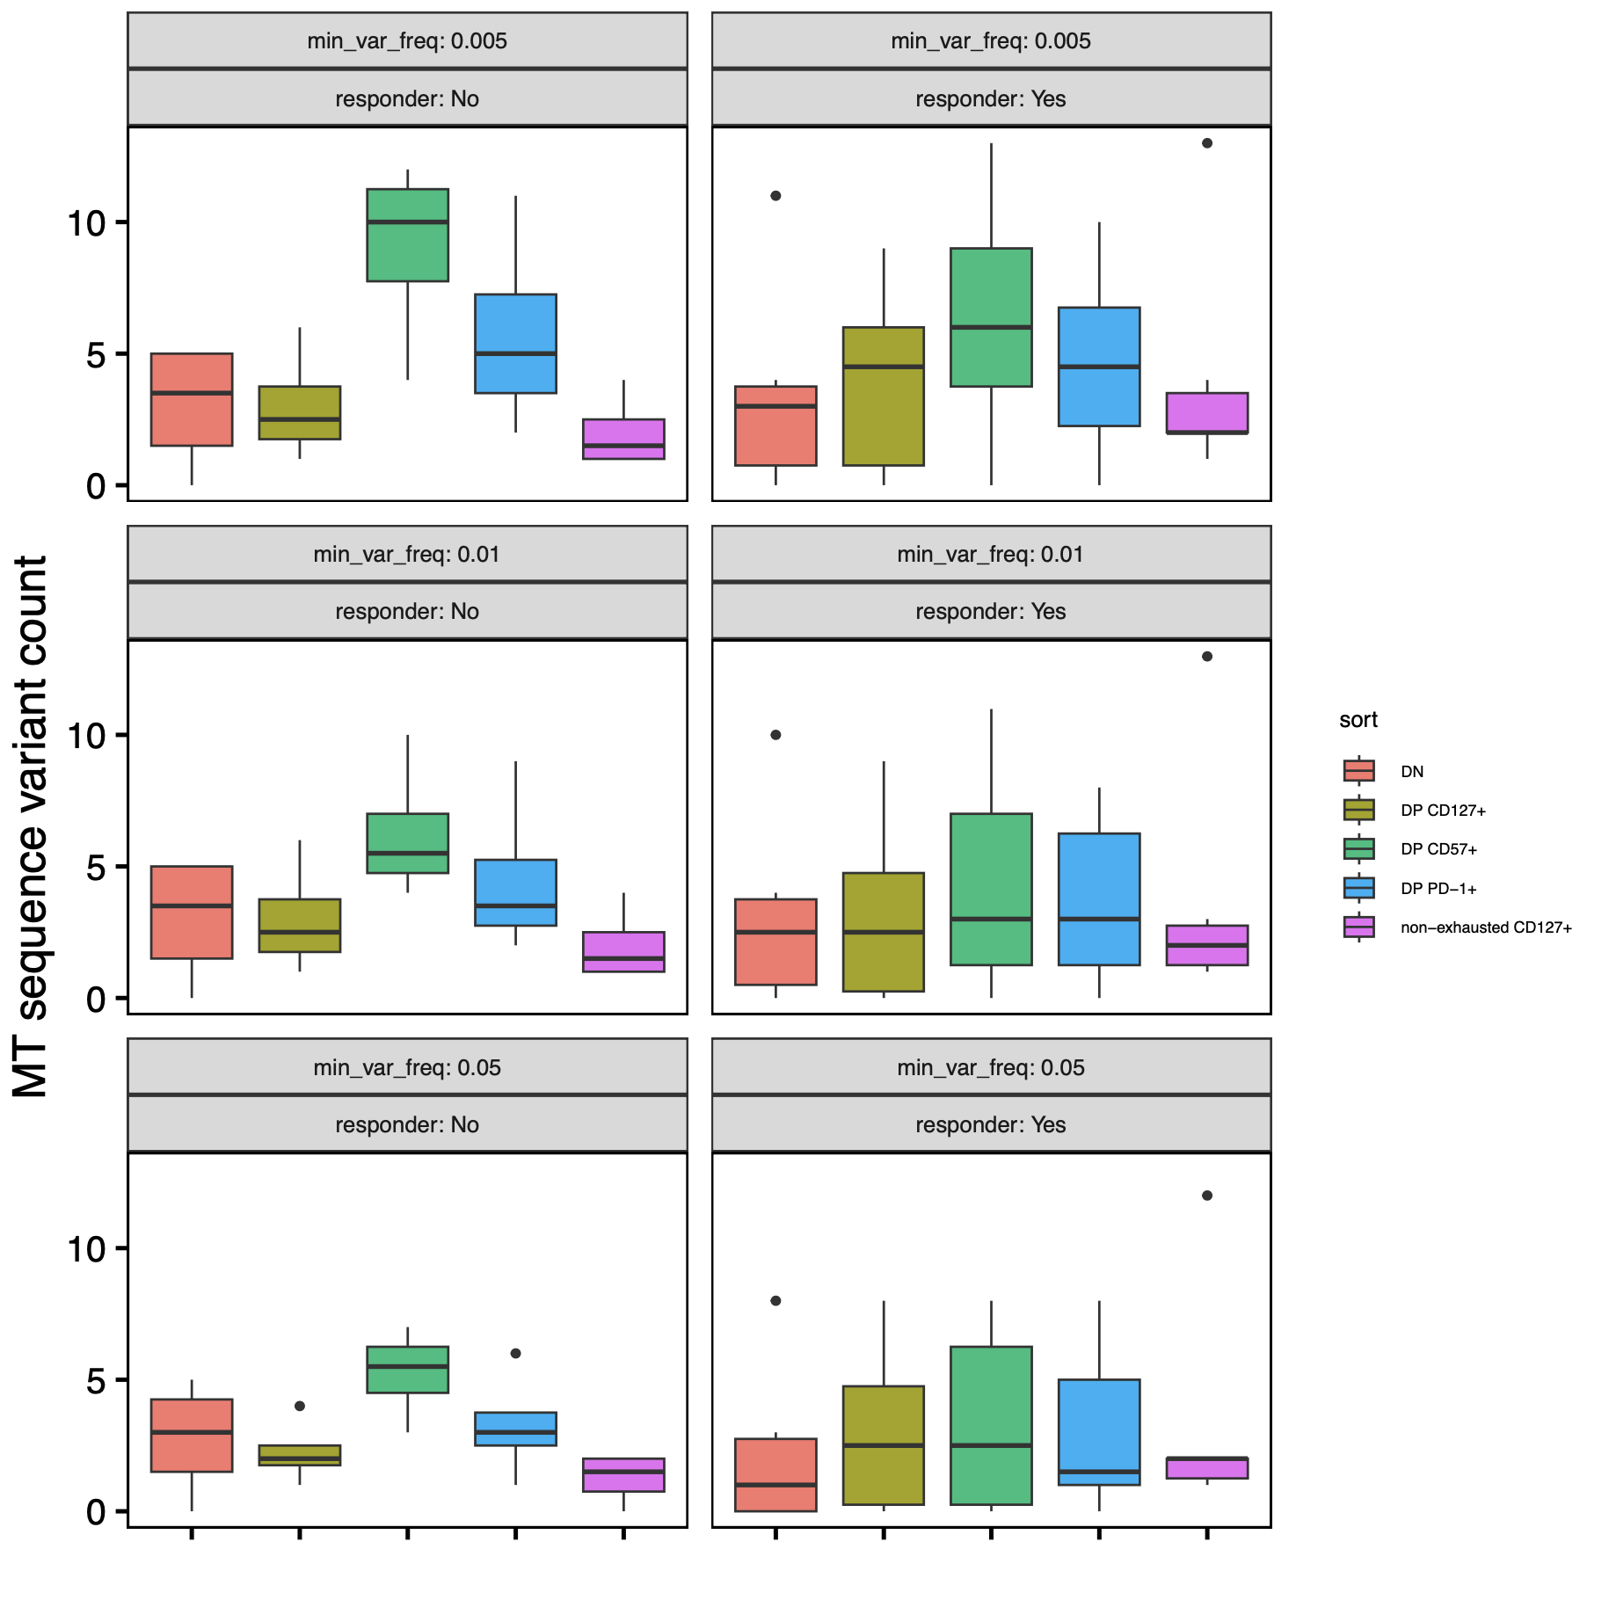
P576: faceting by responder status
*
DP CD57⁺ vars higher than other sorts more dramatic in NR than R
no significant differences in var counts between R and NR within each sort
*
*
n = 6 (R)
n = 4 (NR)
Wilcoxon rank sum test. *; p < 0.05
Notes:
Perhaps DP CD127s more terminal in Rs? Not sure if that was expected/is consistent with other data…

Slide 7
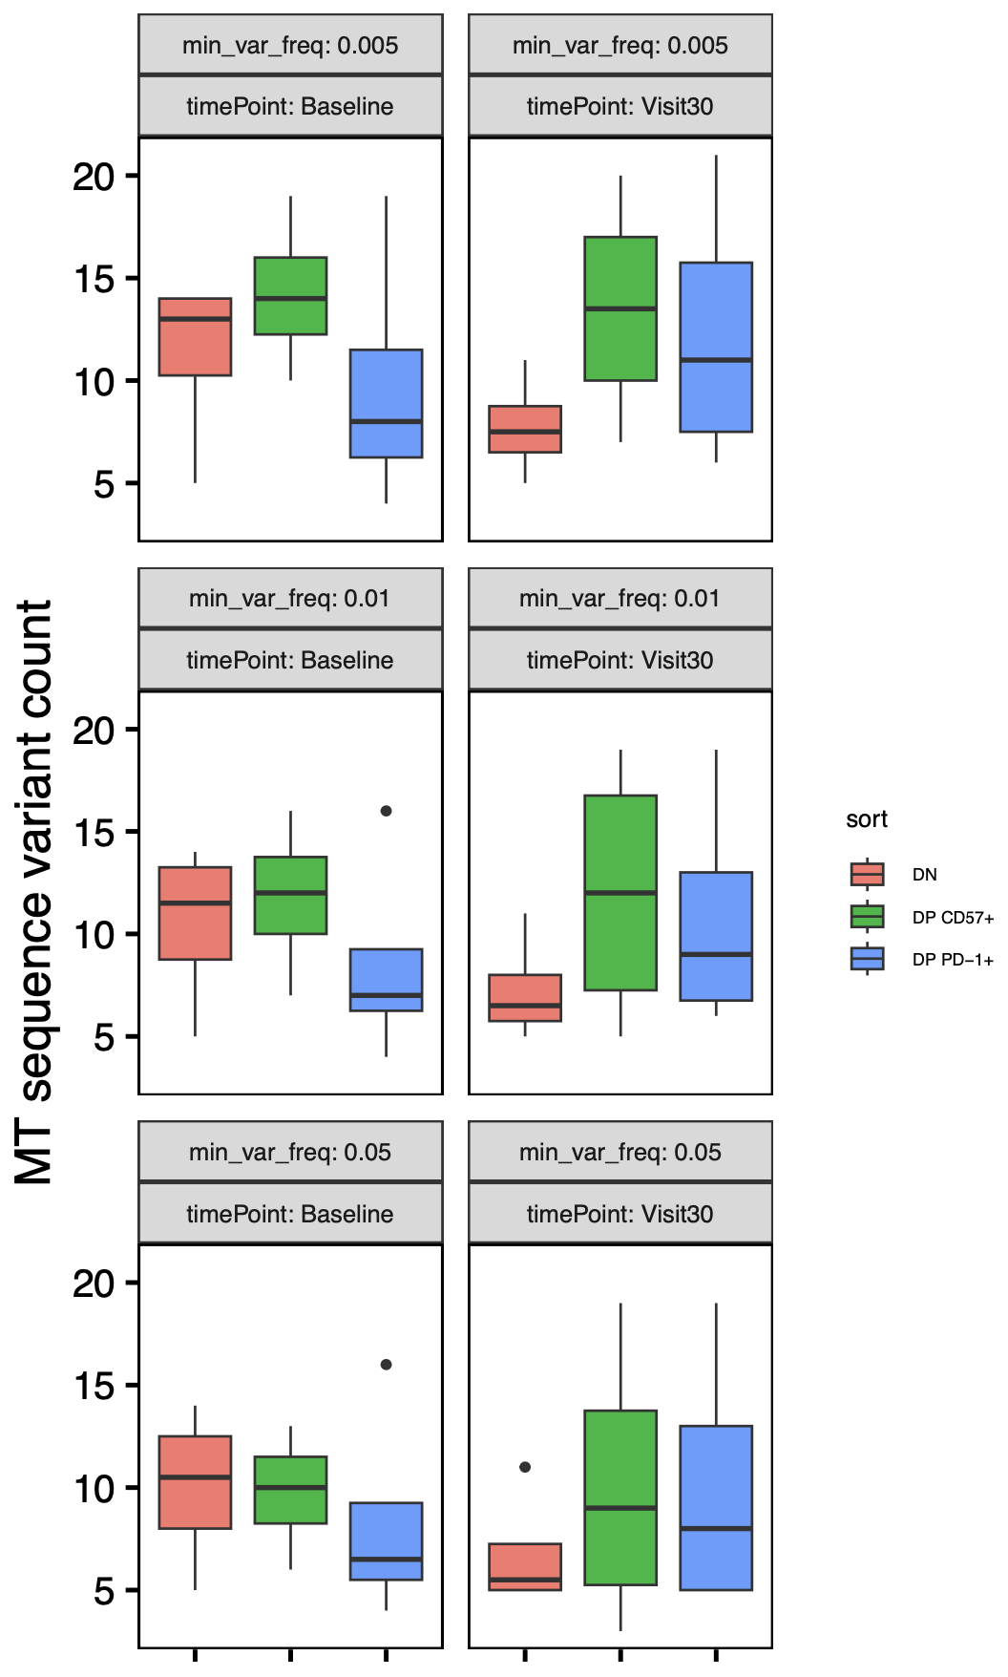
P452: no significant differences in var counts between timepoints, although DP PD-1⁺ vars trend up and DN ones (surprisingly) trend down over time
n = 4 (donors)
Notes:
Expectation from Long lab: increased vars over time in PD-1+ and maybe CD57 already high at baseline
No significant differences between timepoints across cell sorts/min_var_freqs

Slide 8
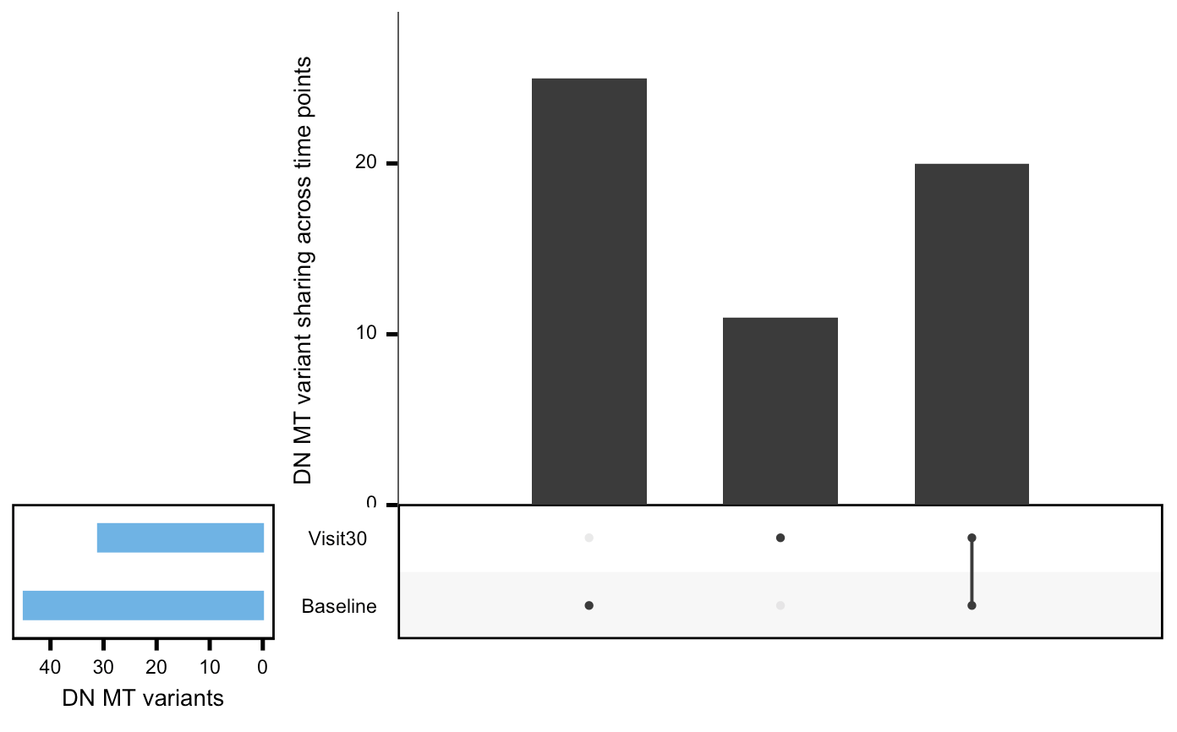
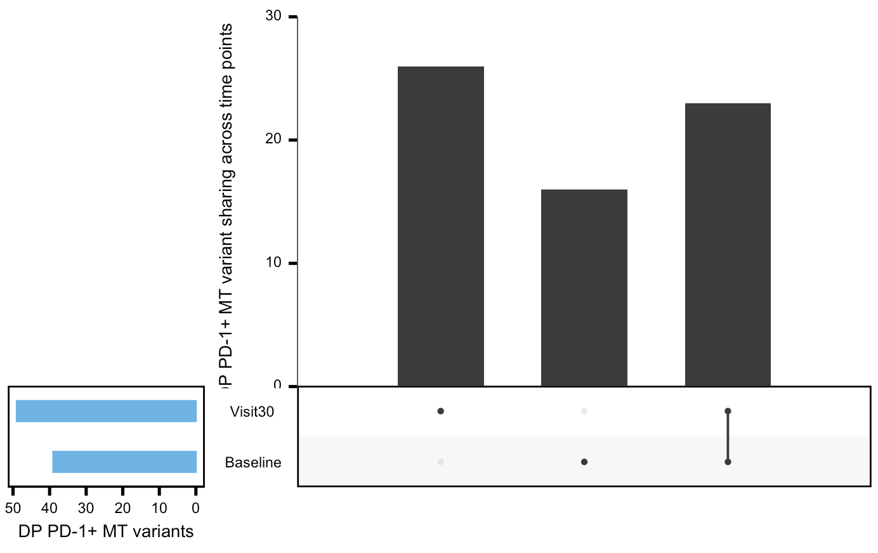
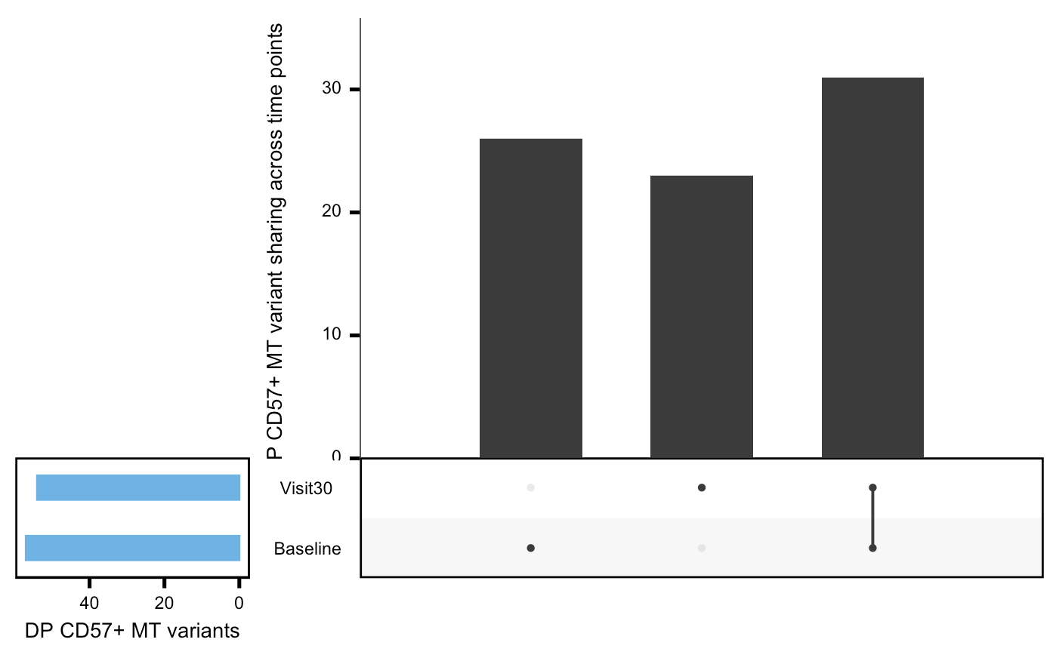
P452: surprisingly observe substantial variant (position) losses and gains in all 3 cell sorts between timepoints
Notes:
Looks ~same if just considering var position not most common mut allele, so it’s that new positioned vars are being gained and lost, not that the most common allele at a var is changing
Expectation from Long lab: increased vars over time in PD-1+ and maybe CD57 already high at baseline
Possible contribution from separate, new parent? Not sure how else to explain high gain/loss of var positions OR perhaps it’s a computational shortcoming somehow…

Slide 9
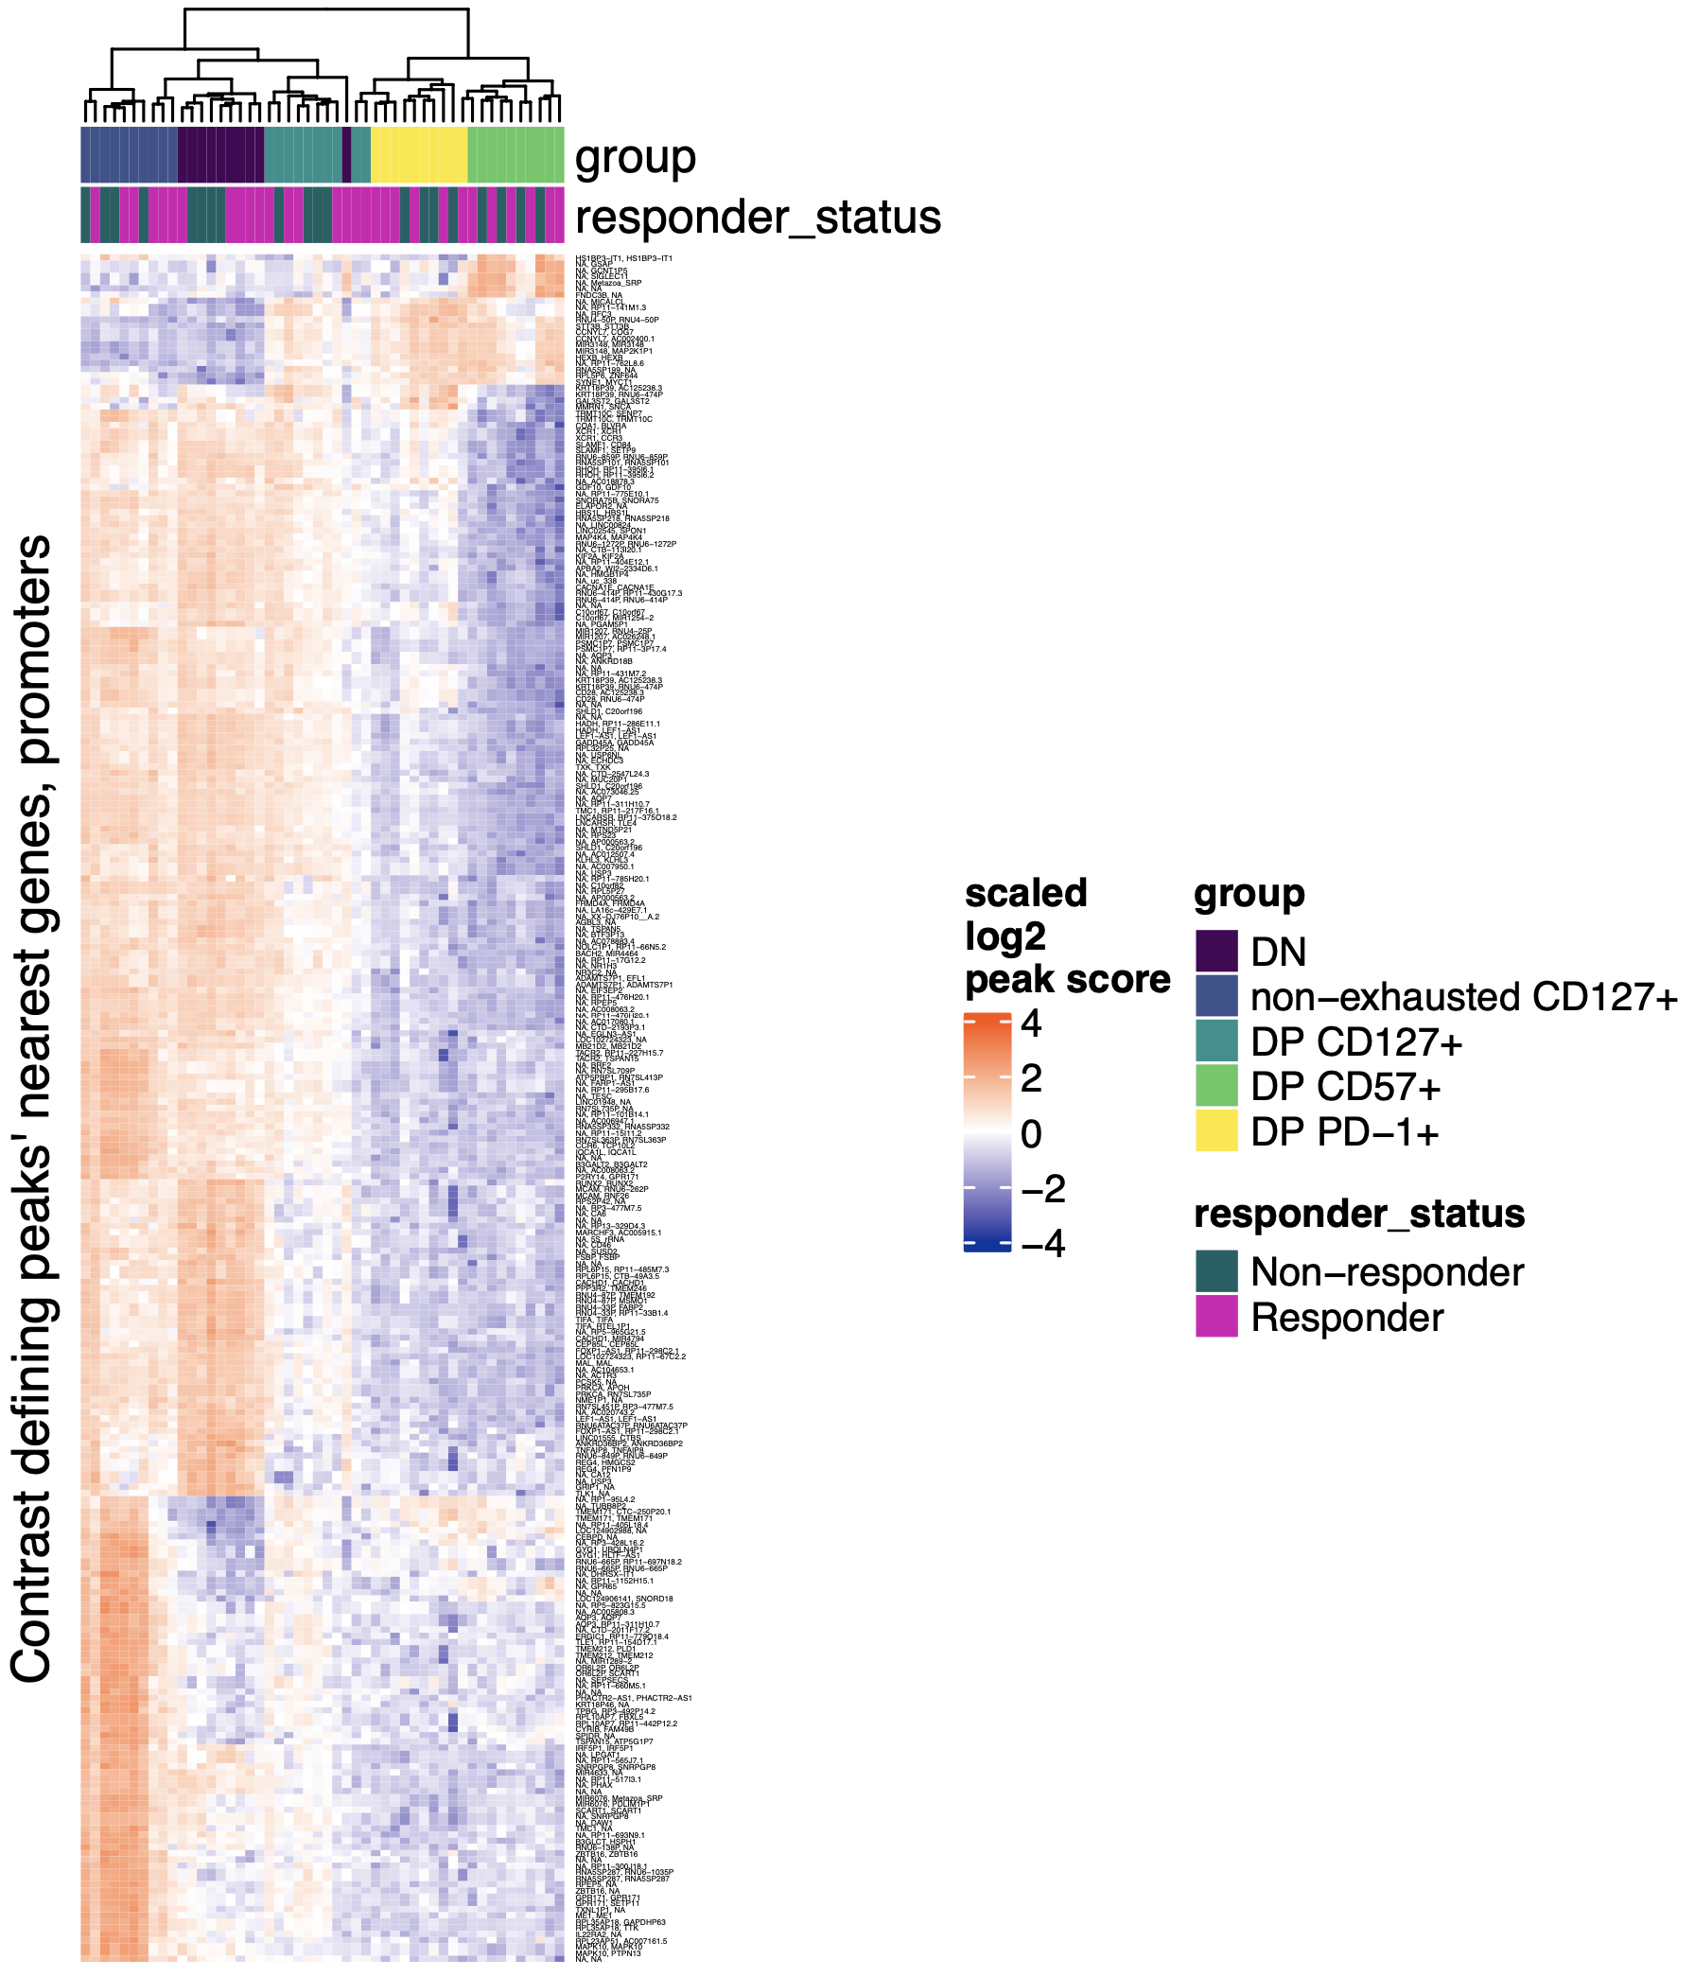
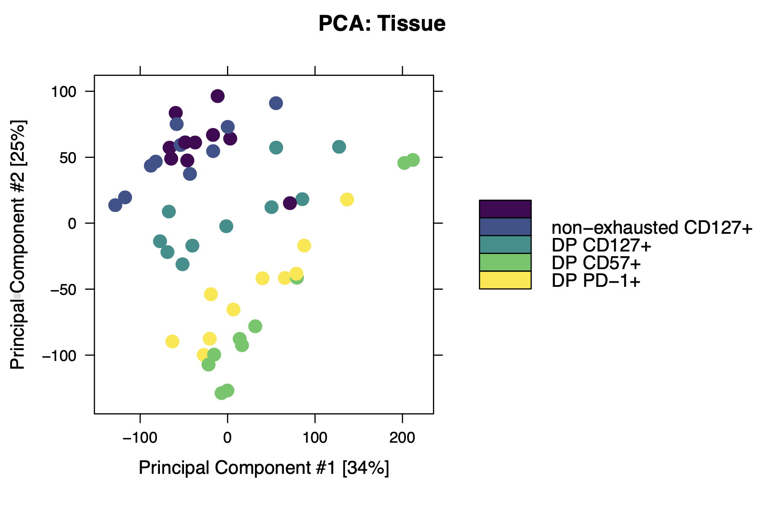
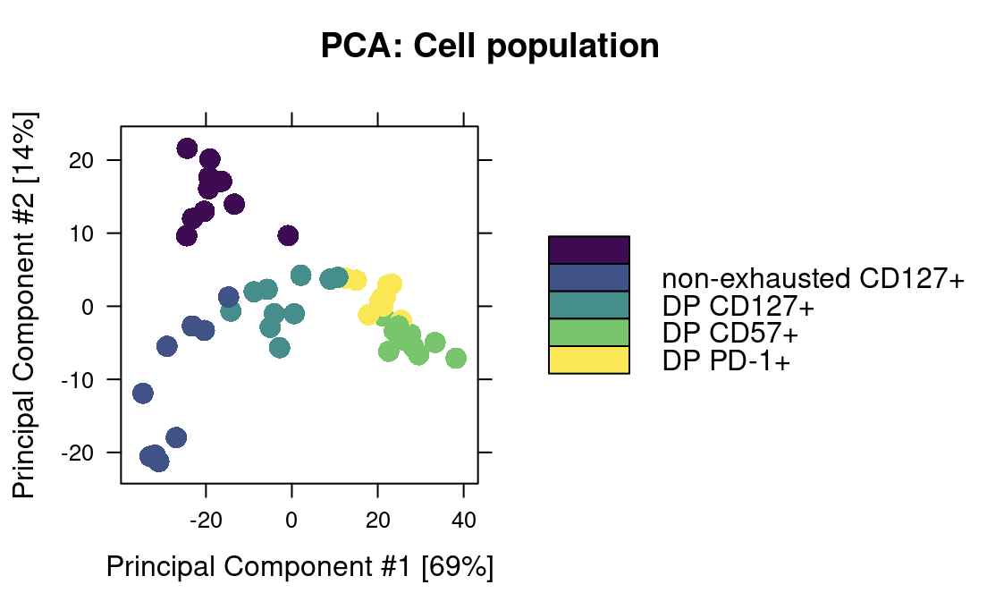
P576: combined heatmap, ~same conclusions as PCA
DN
PCA using heatmap peaks
DN
PCA using all peaks
Notes:
Took top 50 contrast defining peaks per each of 10 contrasts, found unique peaks from these (213, 194 are unique gene-promoter combos but I kept all 213), then annotated rows with nearest genes, promoters
Possible motivation for this is since it’s easy to overinterpret distances in PCA space (biased by projection), so here we can see (here biased by peaks we use for rows) how sorts differ (heatmap color blocks)
Potentially interesting to checkout blocks’ genes, but probably mostly stuff from top corners of VPs that were ~unintelligible (seemingly random genes and stuff)

Slide 10
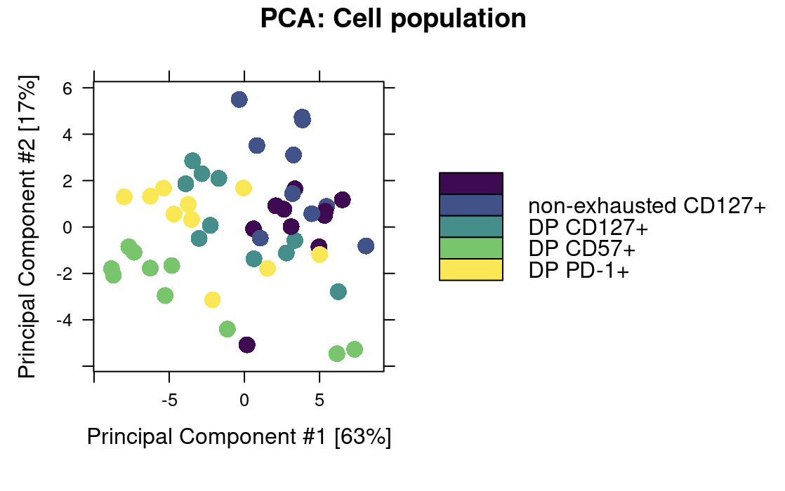
P576: PCA using peaks near exhaustion/cytotoxicity genes doesn’t capture sort differences nearly as well, consistent with scrambled heatmap clustering
DN
DN
PCA using all peaks
PCA using peaks near cytotoxicity/exhaustion genes
Notes:
P576 peak score heatmaps by cell sort AND responder status: responder status annotation doesn’t add any info to clustering of cytotoxicity/exhaustion gene/promoter peaks (data not shown)

Slide 11
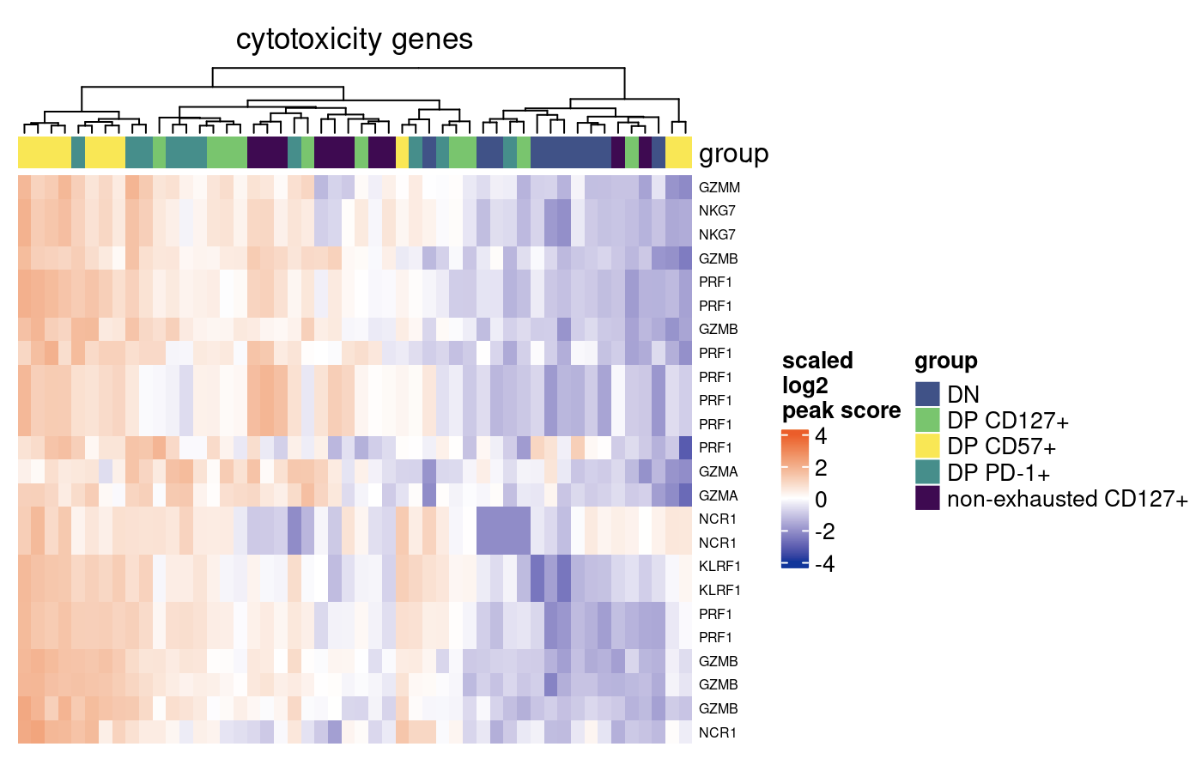
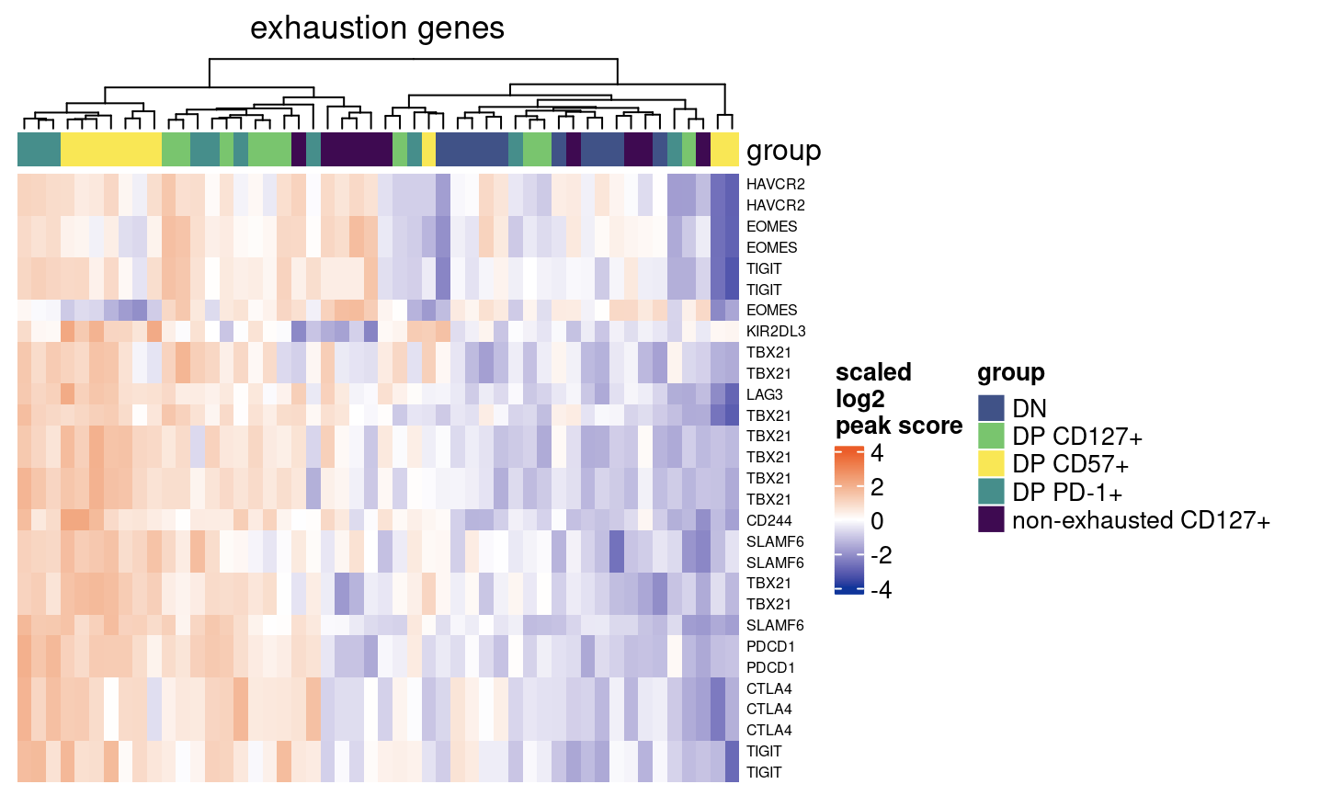
P576: Scrambled heatmap clustering when using peaks only near cytotoxicity/exhaustion genes

Slide 12
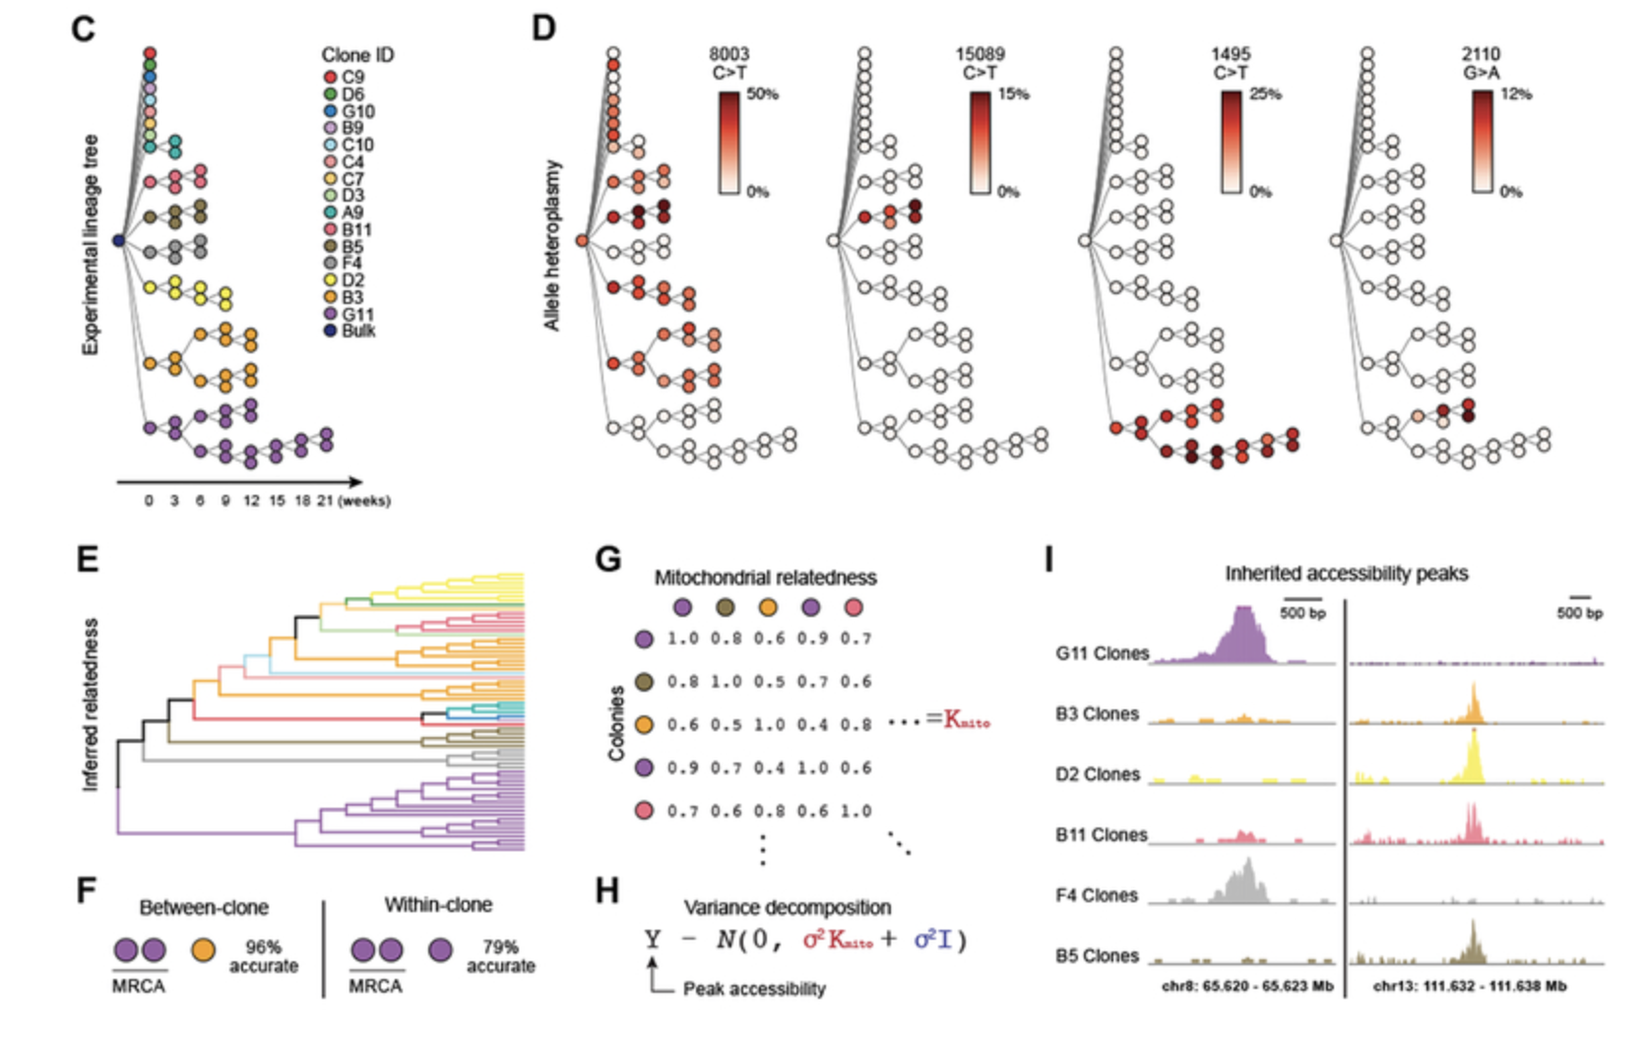
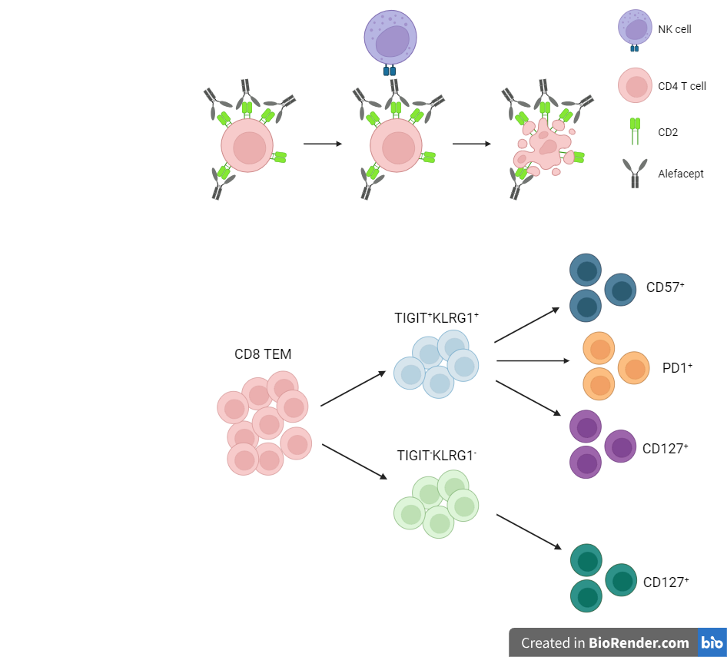
Next experiment ideas
Unique benefits of scATAC/STAMP over bulk
scATACseq: if interested in both MT genome (SNVs) and nuclear genome (> 80% of reads likely), established method
scSTAMP: new method, sequencing by targeted amplification of multiplex probes, if only interested in MT genome, already applied in human immune cells (Guo et al, 2022, PNAS)
More sequencing of current libraries: perhaps could help power MT variant analyses (although will only expect <20% of new reads to map to MT genome)
Plan: create fig E diagram and color by cell sort
Perhaps would want to change sorting strategy to include parent DP. PD-1⁺ and CD57⁺, or CD127⁺ ever co-expressed?
TIGIT⁺
KLRG1⁺ (DP)
non-naive
CD8s
DP CD57⁺
Ludwig et al. (2020) Cell
DP PD1⁺
DP CD127⁺
non-exhausted (not DP) CD127⁺
TIGIT⁻KLRG1⁻ (DN)
Notes:
For sc lineage tracing, I think sorts should include some stuff from along each “step” of lineage

Slide 13
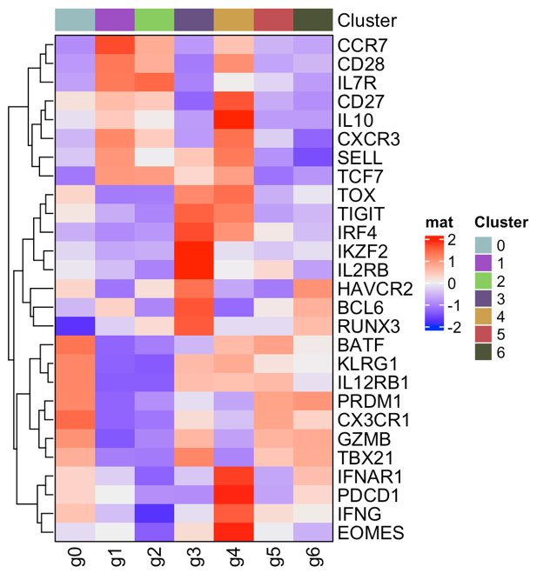

Josh’s presentation debrief, perhaps could try looking in ATAC data for accessibilities of genes co-expressed with CD127 here
FlowSOM clustering
Markers of Exhaustion
Highlighted clusters here seem more like non-exhausted CD127⁺ than DP CD127⁺?

Slide 14
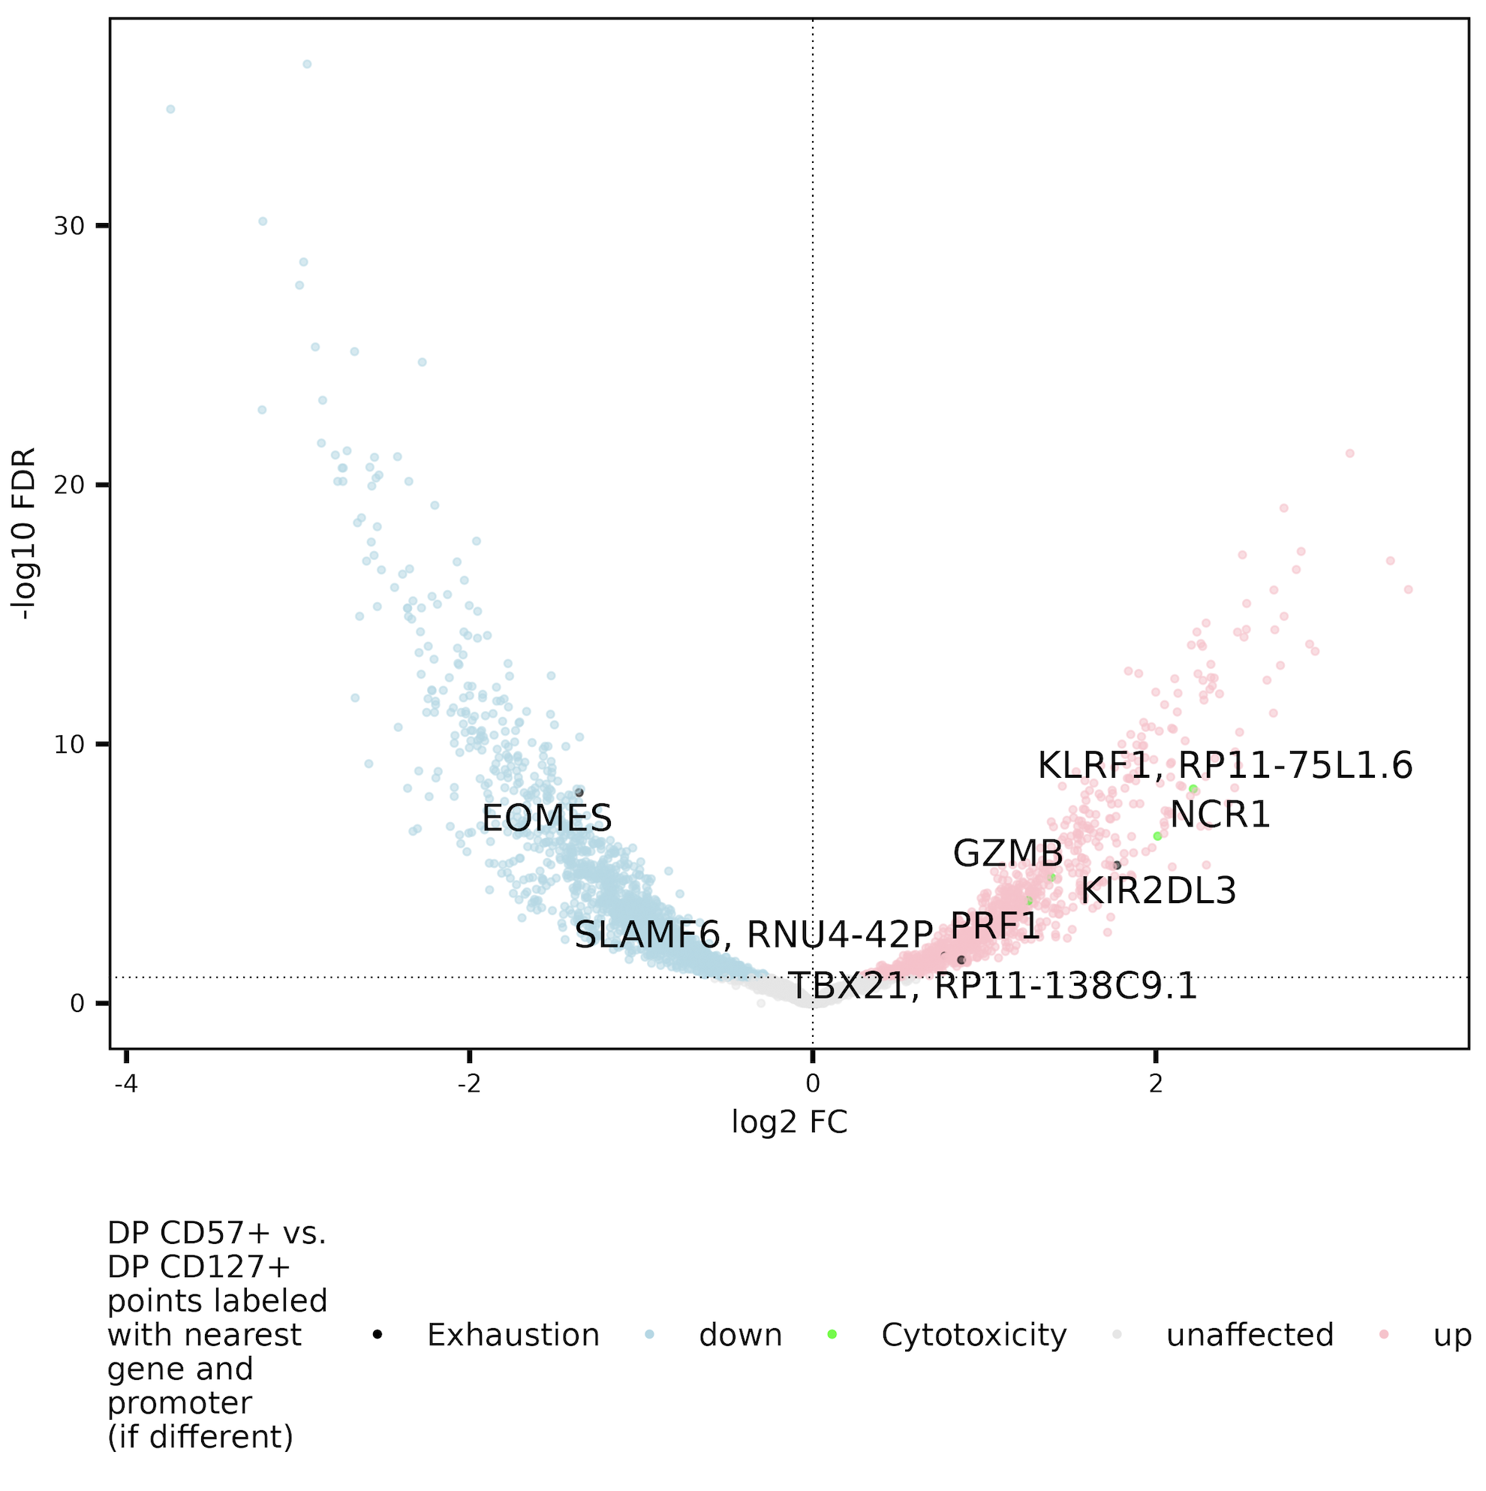
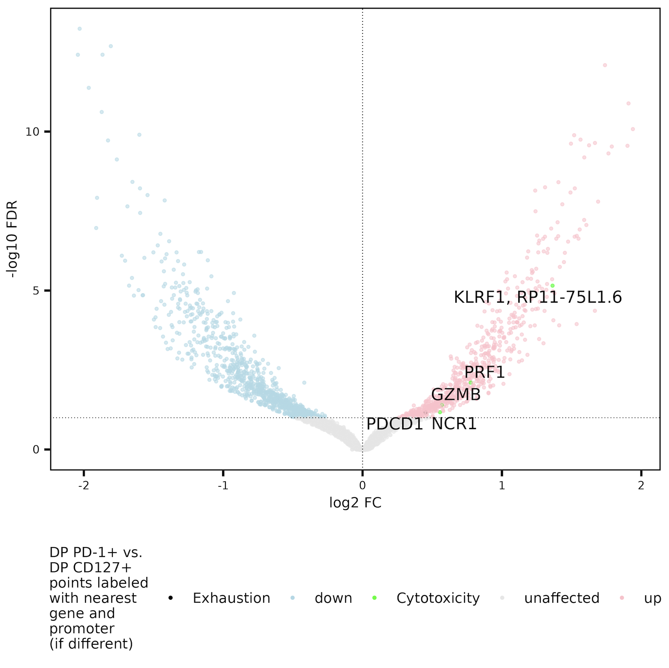
DP CD127⁺ do seem less T_{eff} than DP PD-1⁺, peaks near EOMES gene/promoter more accessible in DP CD127⁺ than DP CD57⁺
Exhaustion: CD244, SLAMF6, TBX21, PDCD1, HAVCR2, KLRG1, TOX, TCF1, PD1, CTLA4, LAG3, TIM3, TIGIT, KIR3DL2, KIR2DL3, NKG2A
Cytotoxicity: GZMA, GZMB, GZMH, GZMM, GZMK, PRF1, NCR1, KLRF1, NKG7
Notes:
EOMES may just be down in CD57 (seen in CD57 vs. PD1 as well down in CD57… I think), so not specific to CD127 per se maybe

Slide 15
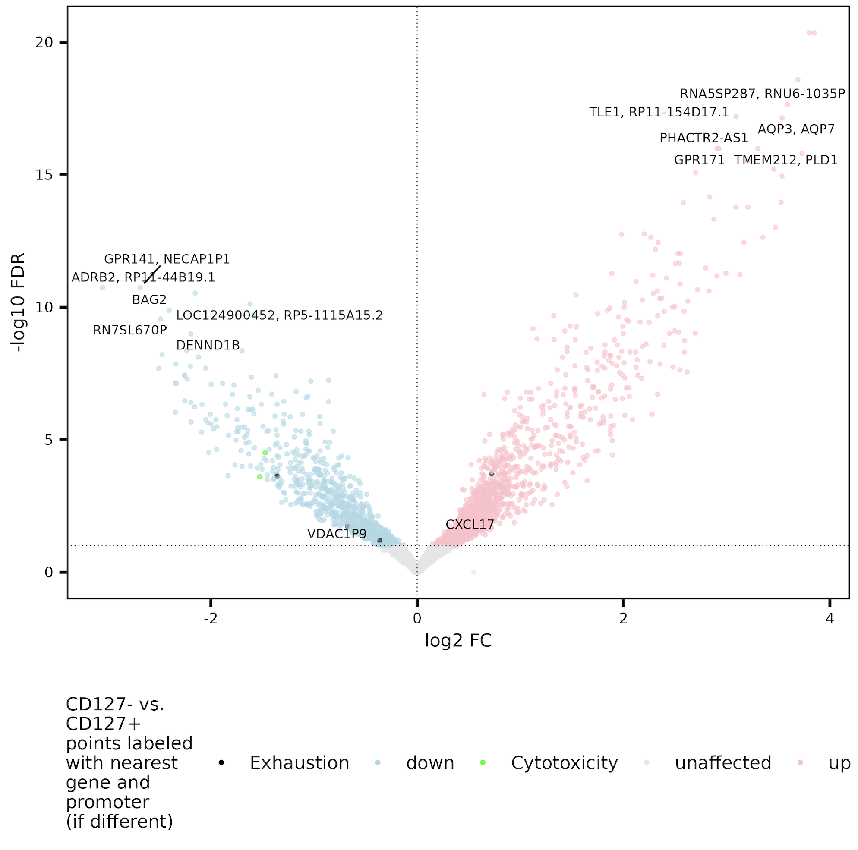
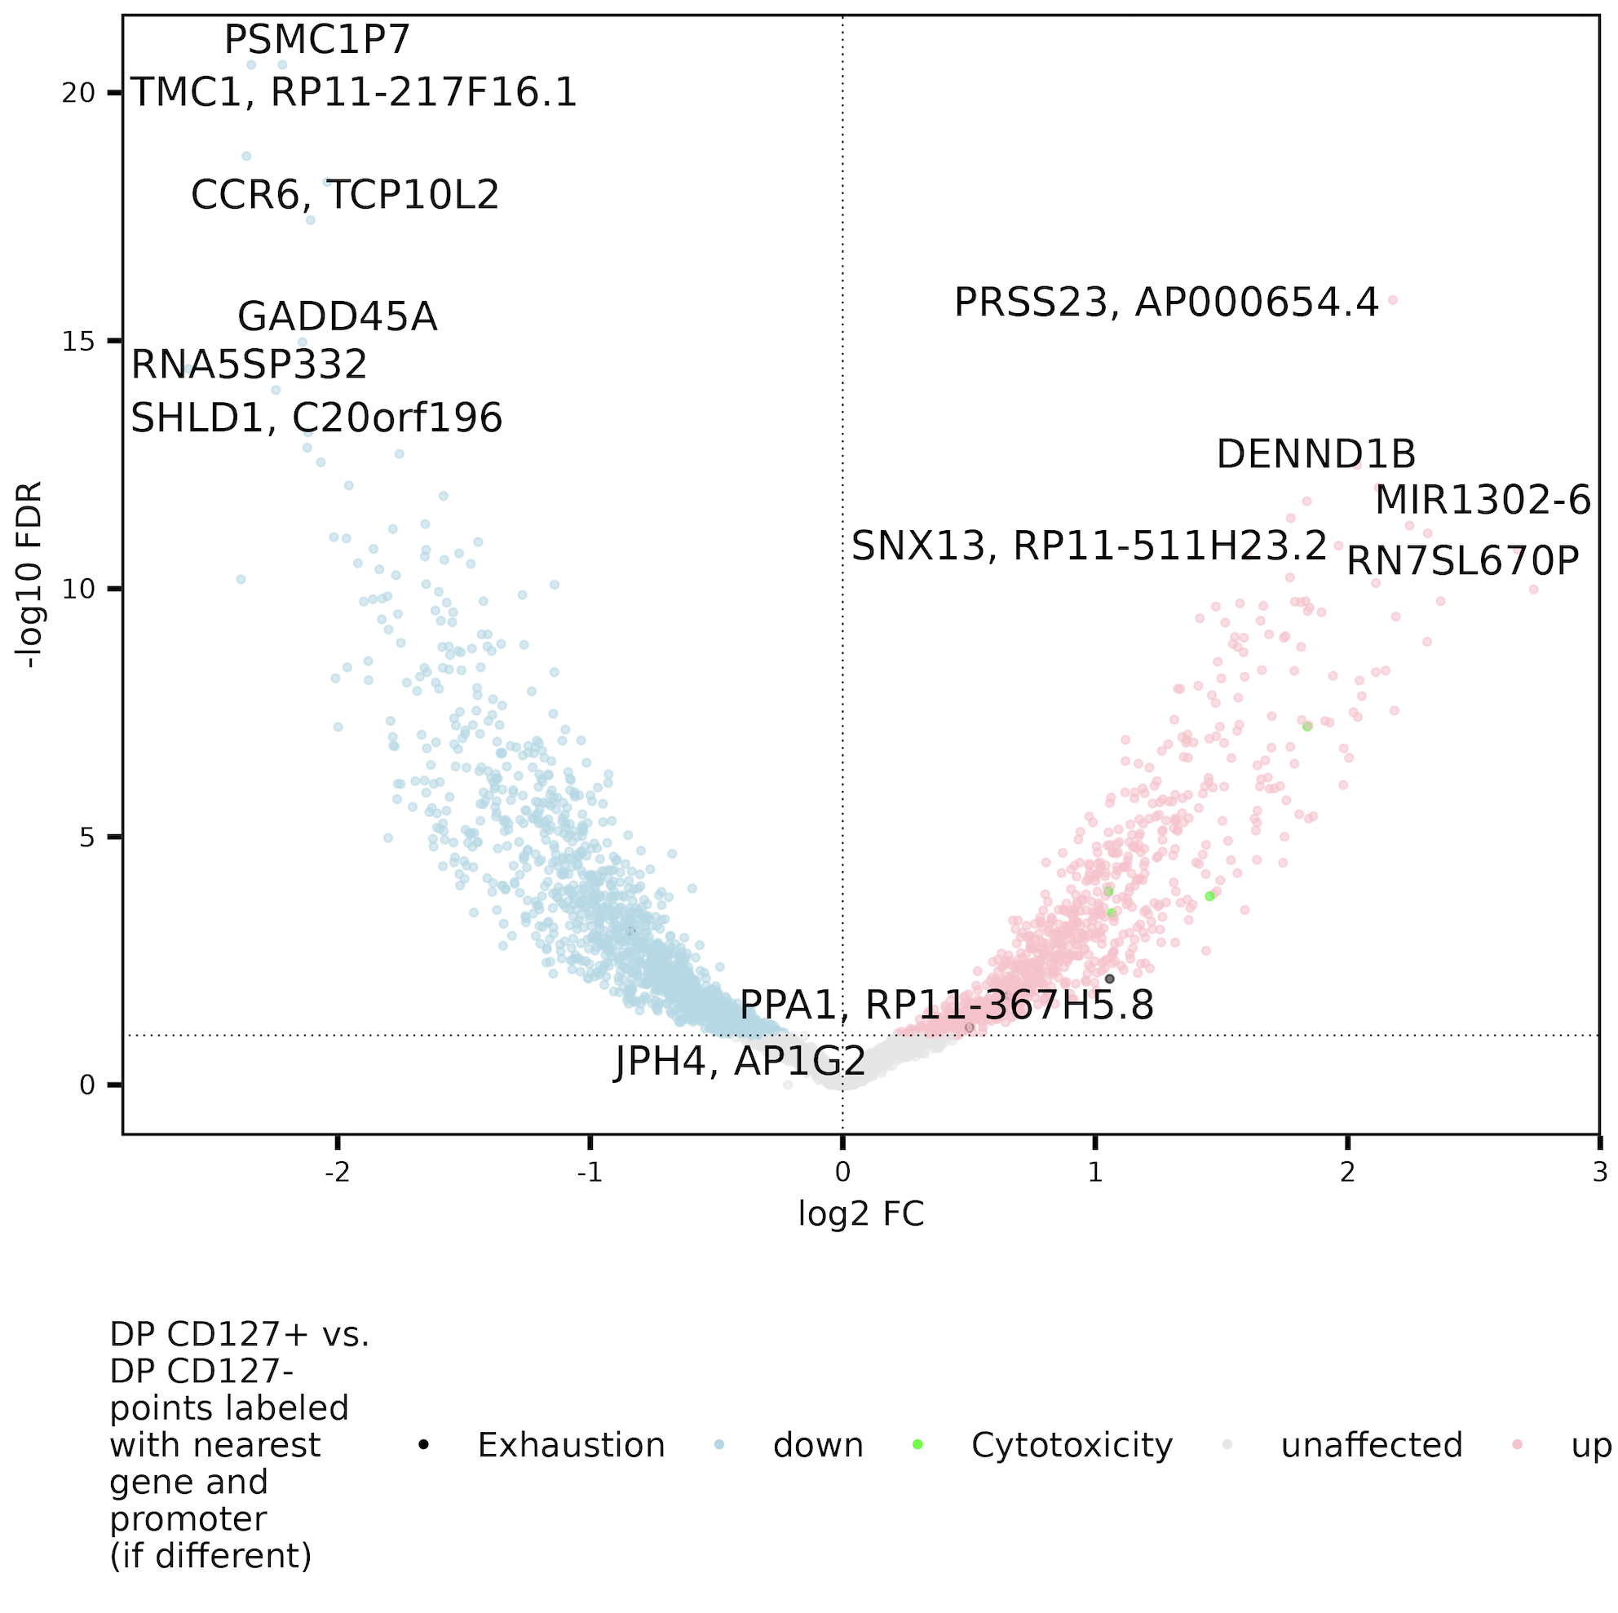
Looking at CD127⁺ vs. CD127⁻ and DP CD127⁺ vs. DP CD127⁻ doesn’t really help answer if CD127s are more T_{eff} or T_{ex}
Exhaustion: CD244, SLAMF6, TBX21, PDCD1, HAVCR2, KLRG1, TOX, TCF1, PD1, CTLA4, LAG3, TIM3, TIGIT, KIR3DL2, KIR2DL3, NKG2A
Cytotoxicity: GZMA, GZMB, GZMH, GZMM, GZMK, PRF1, NCR1, KLRF1, NKG7
Notes:
Both are consistent with both green and black dots (cyto/ex) genes up in (DP) CD127+ which is unhelpful for overarching Q on title of slide

Slide 16
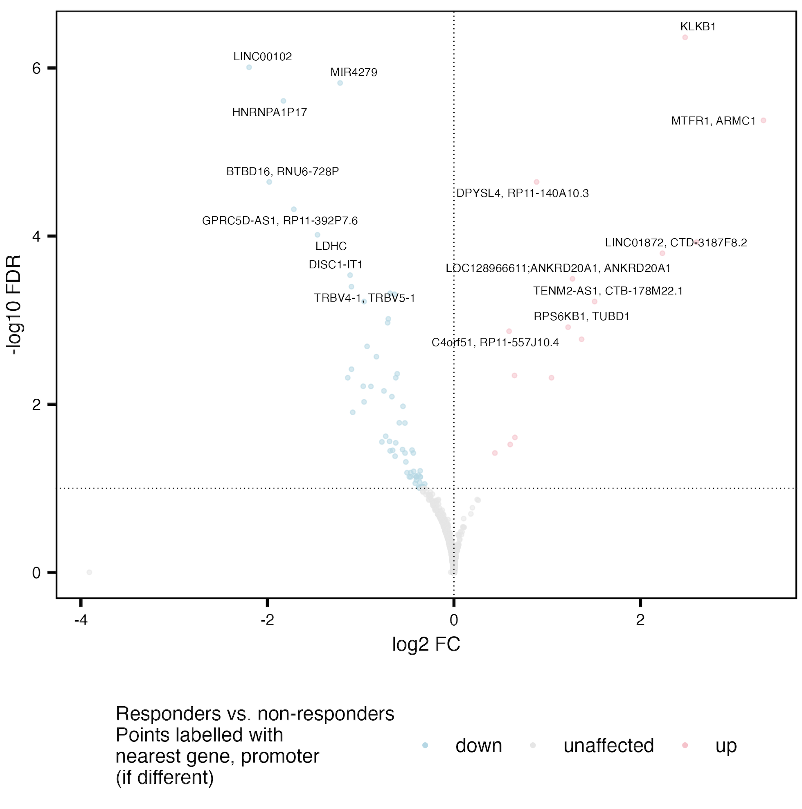
Do see some overlap (bolded) of R vs. NR DARs in grouped cell sort (right) vs. 1 at a time (listed below)
C10orf128
F8A1
MIR1184-1
AC007679.3
PPIAP68
C10orf71
DISC1
DISQ
BTBD16
RNU6-728P
MIR4279
Notes:
Plot/analysis made with new covariate regressing out code
Adjusted for donor and responder status effects when comparing cell sorts (no big changes) and donor and sort effects when comparing R vs. NR

Slide 17
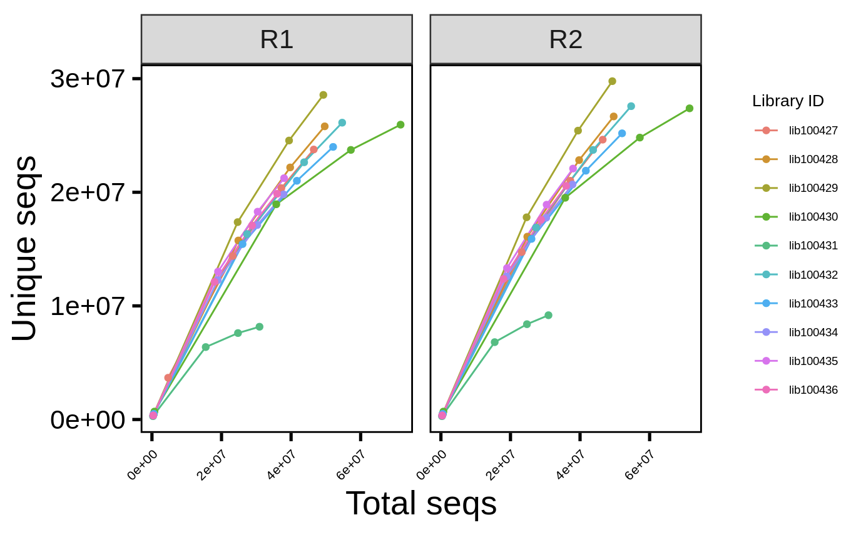
Next steps
Check out ATAC peak accessibilities near genes from lists from Josh’s presentation
High in CD127⁺: CCR7, CD28, CD27, IL10, CXCR3, SELL, TCF7
Low in CD127⁺: TOX, IRF4, IKZF2, IL2RB, HAVCR2, RUNX3, BATF, IL12RB1, PRDM1, CX3CR1, GZMB, TBX21, IFNAR1, IFNG
Complete saturation curves for all 50 P576 libraries before committing to additional sequencing (few libraries appeared to be more saturated than others)
Re-run variant calling on downsampled P576 to get a sense of how much additional sequencing might help?
only ~20% of libraries tested so far (computationally slow)

